Slide 1
Chapter 1 Propositional Logic

Slide 2
Propositional Logic
Logic contains rules and techniques to formalize statements, to make them precise.
Logic appears in different areas of computer science, such as programming, circuits, articial intelligence and databases.

Slide 3
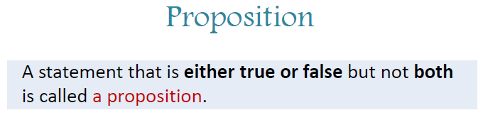
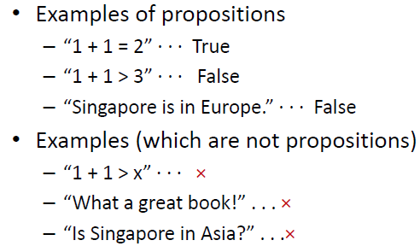

Slide 4
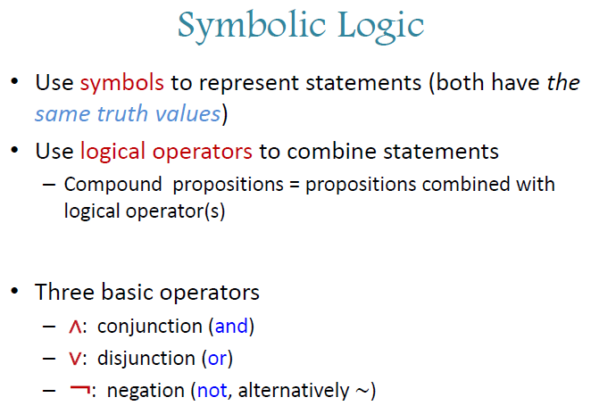

Slide 5
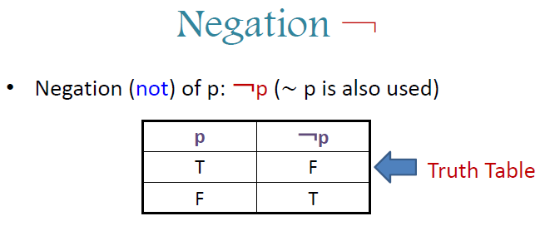


Slide 6
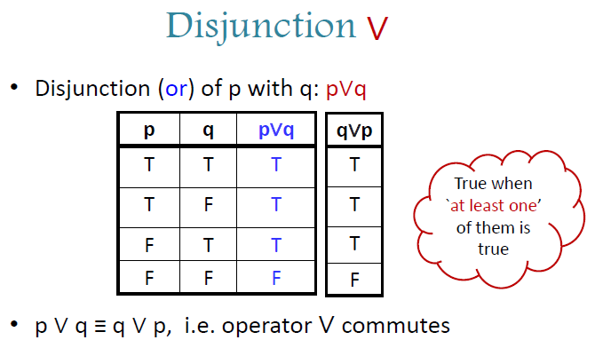


Slide 7

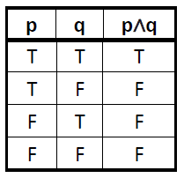
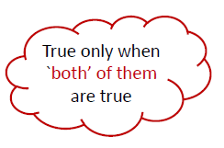


Slide 8
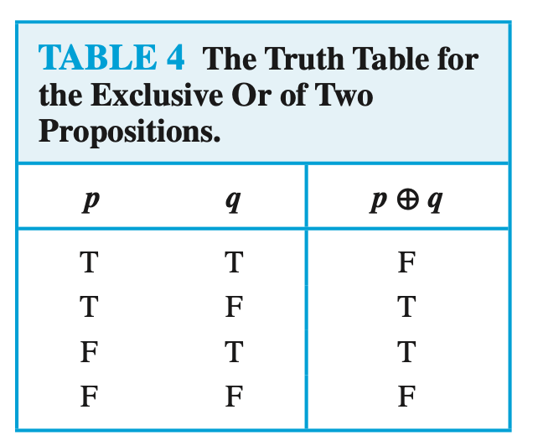
Exclusive or
Definition: Let p and q be propositions. The exclusive or of p and q, denoted by p ⊕ q, is the proposition that is true when exactly one of p and q is true and is false otherwise.

Slide 9
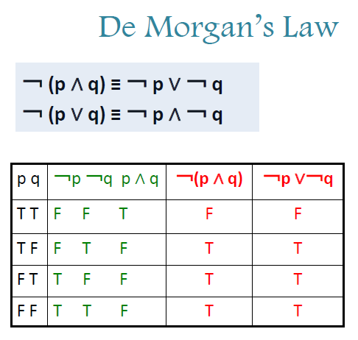

Slide 10
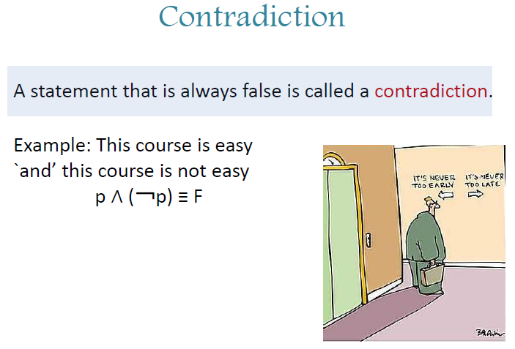

Slide 11
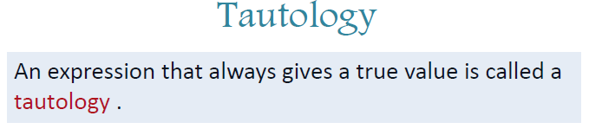
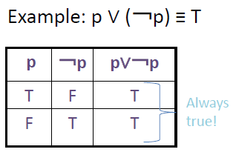

Slide 12
Logical equivalence
Compound propositions that have the same truth values in all possible cases are called logically equivalent

Slide 13
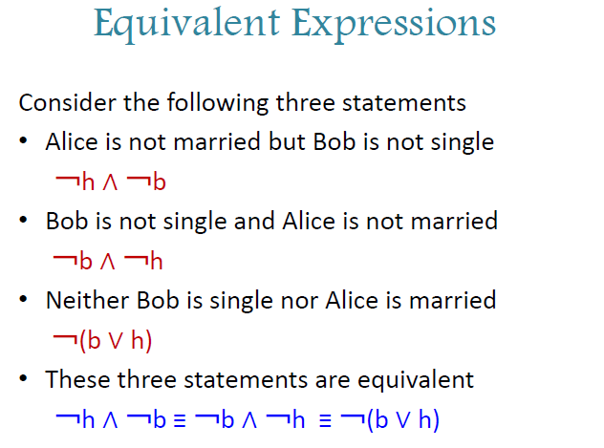

Slide 14
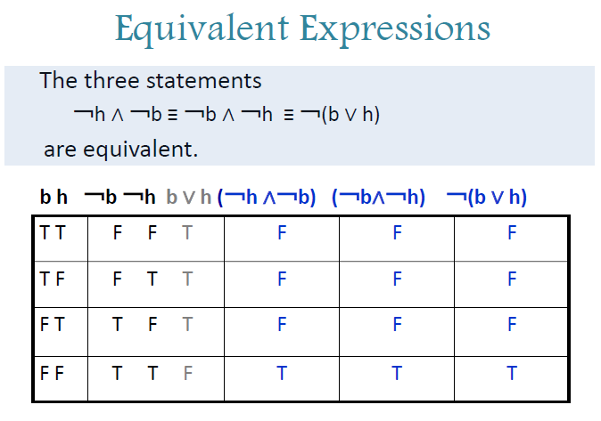

Slide 15
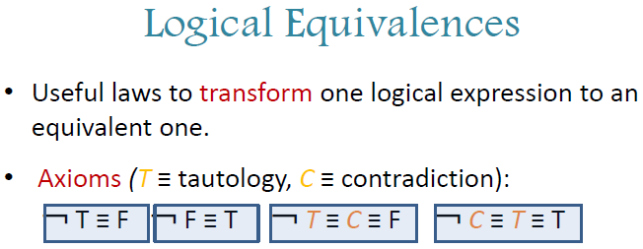
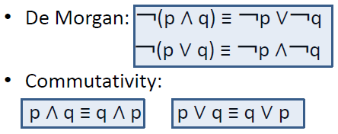

Slide 16
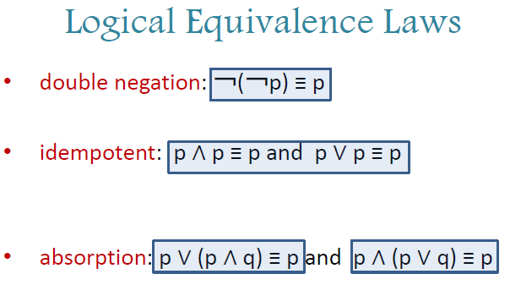

Slide 17
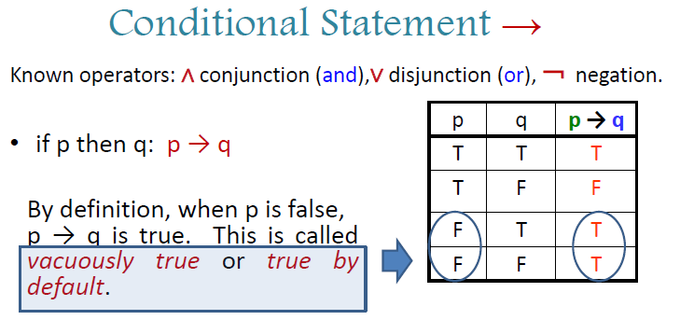

Slide 18
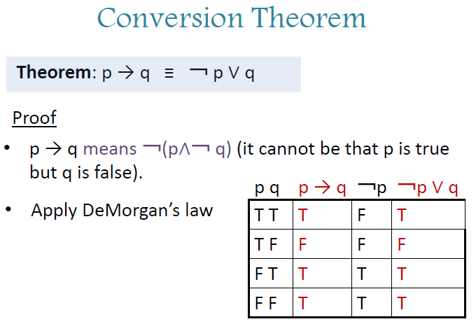

Slide 19
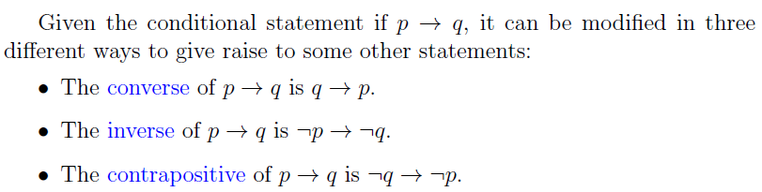
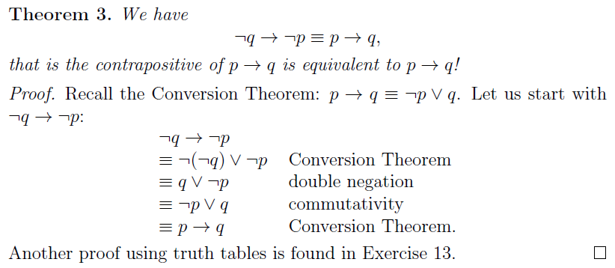

Slide 20

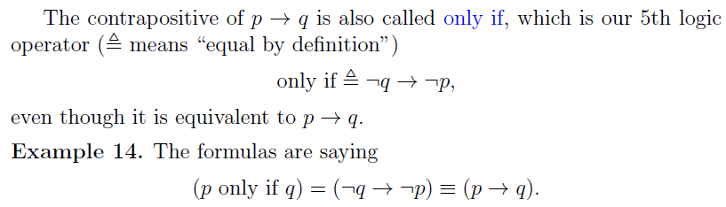

Slide 21
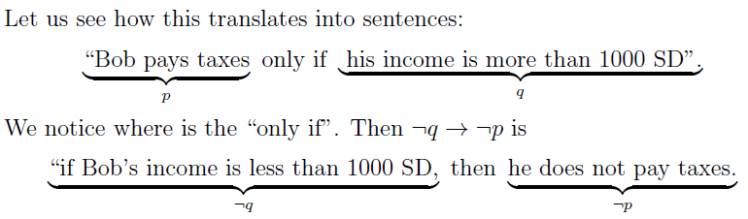
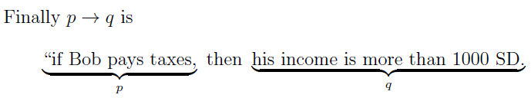

Slide 22
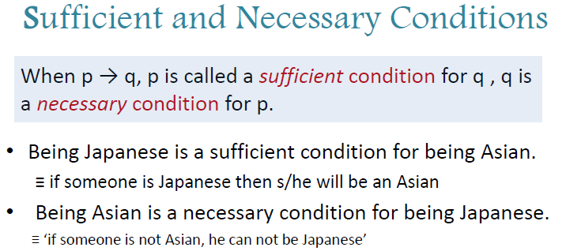

Slide 23
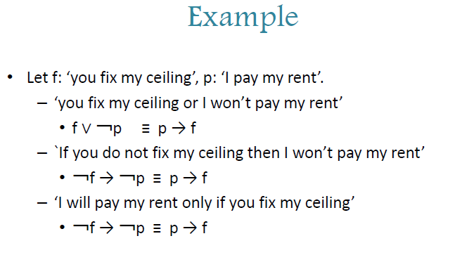

Slide 24
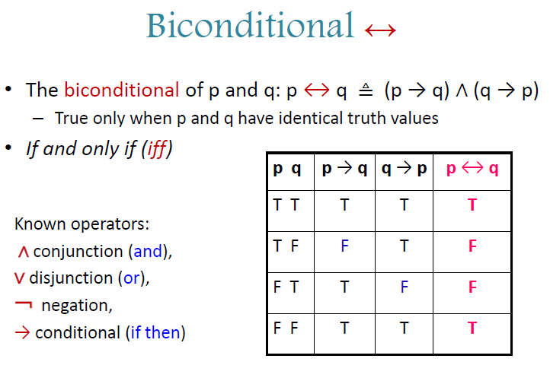

Slide 25
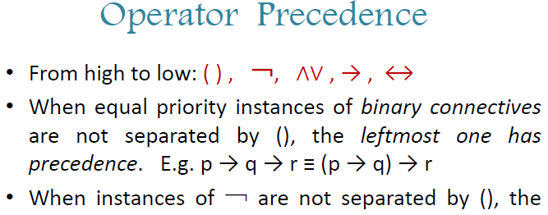


Slide 26
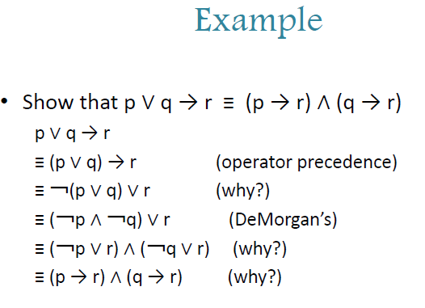

Slide 27
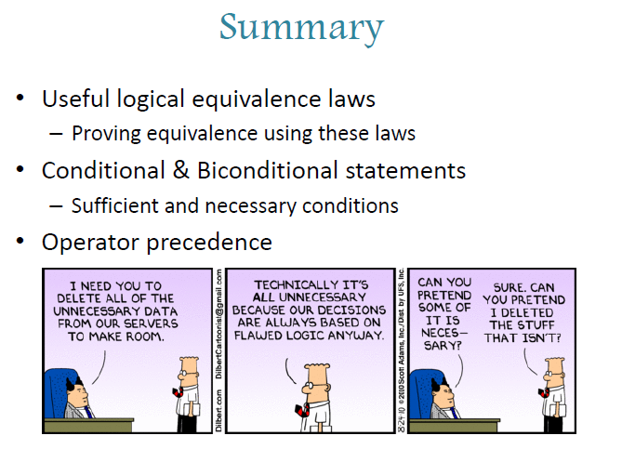

Slide 28

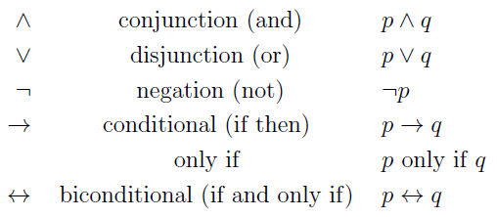


1. Logic operator:
2. Operator precedence:
3. Important logical equivalences

Slide 29
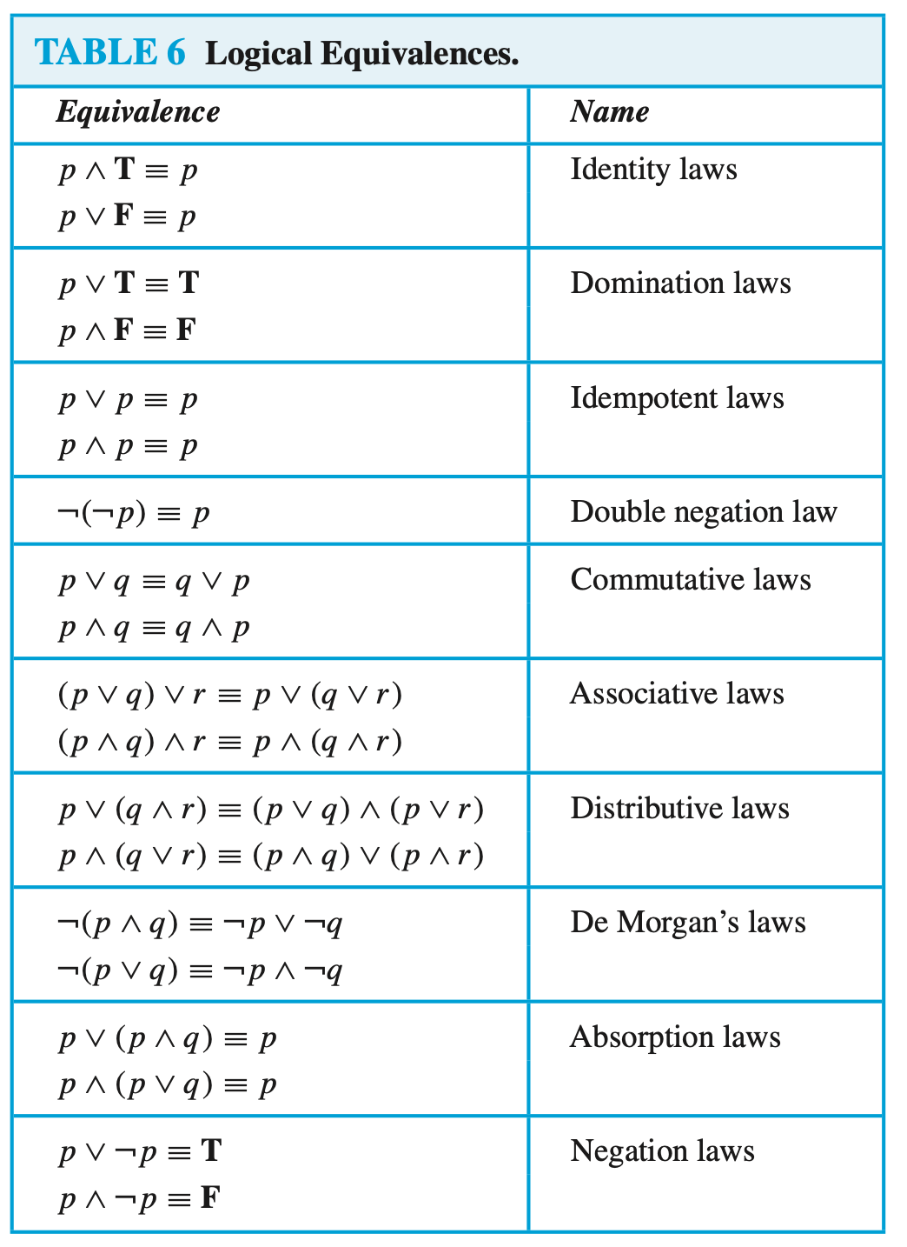
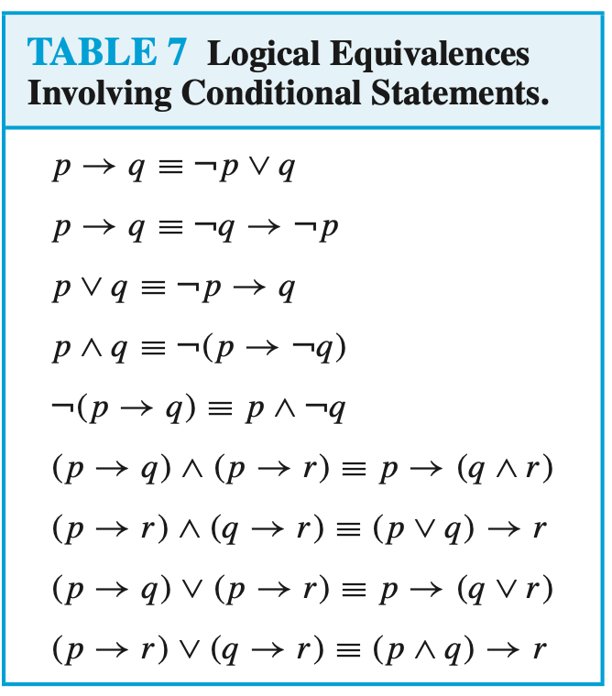

Slide 30
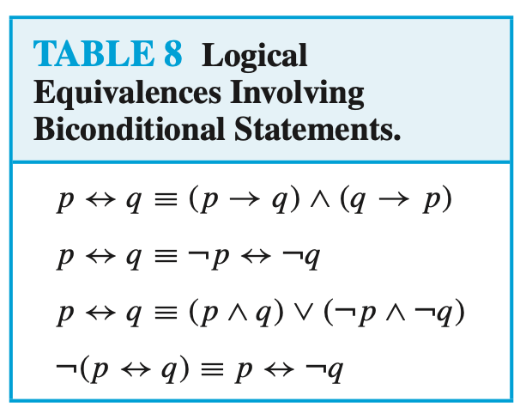

Slide 31

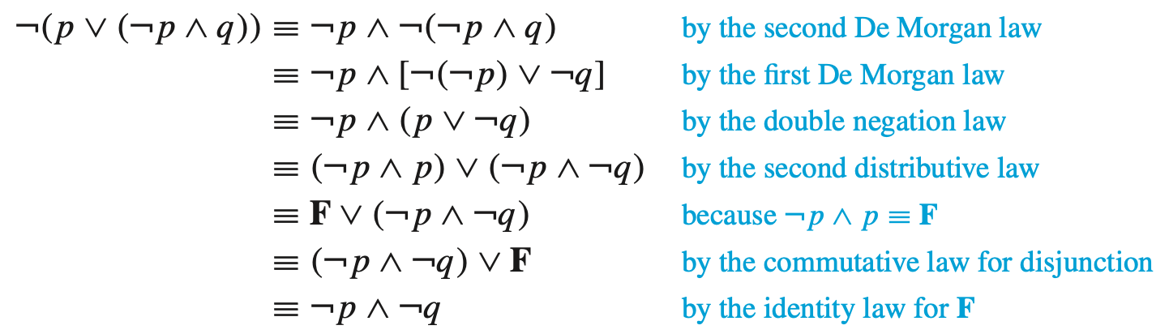
Example: Show that
are logically equivalent by developing a series of logical equivalences.

Slide 32
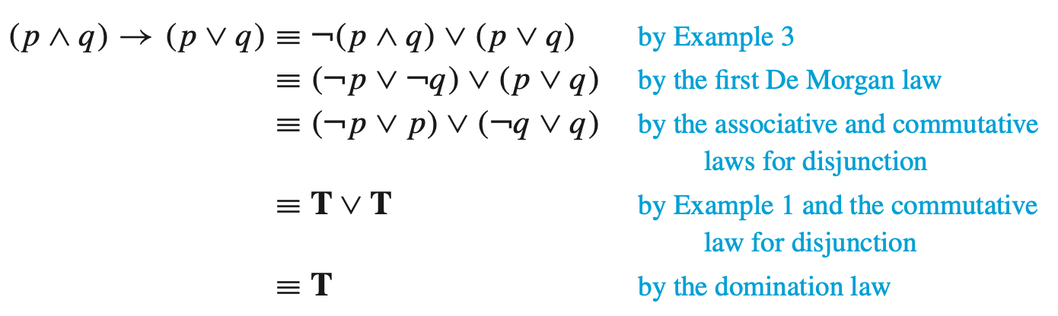
Example:

Slide 33
Propositional Satisfiability
Definition: A compound proposition is satisfiable if there is an assignment of truth values to its variables that makes it true.
When the compound proposition is false for all assignments of truth values to its variables, the compound proposition is unsatisfiable.
When we find a particular assignment of truth values that makes a compound proposition true, we have shown that it is satisfiable; such an assignment is called a solution of this particular satisfiability problem.
To show that a compound proposition is unsatisfiable, we need to show that every assignment of truth values to its variables makes it false.

Slide 34
Example:
Determine whether the compound propositions
is satisfiable

Slide 35
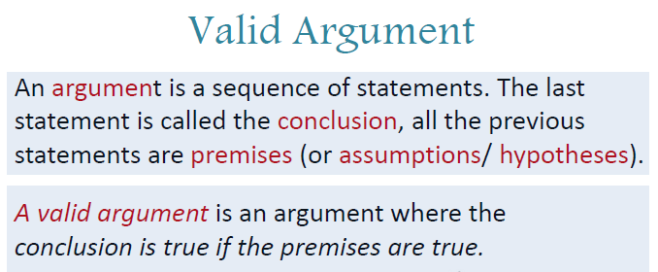

Slide 36
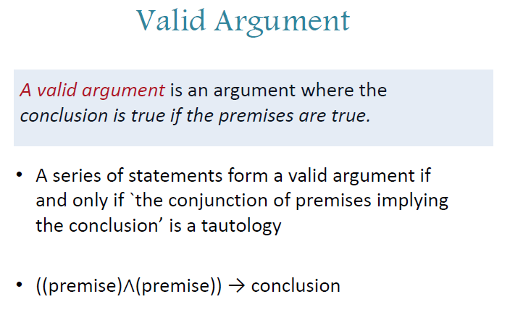

Slide 37
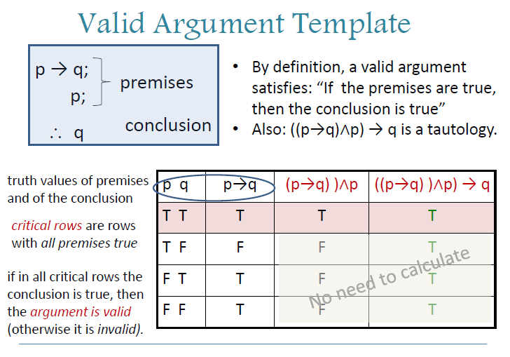

Slide 38
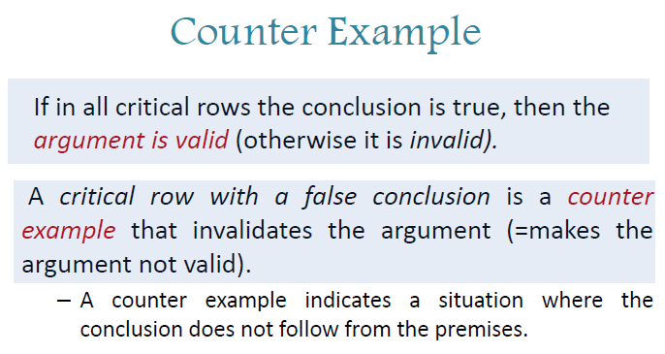

Slide 39
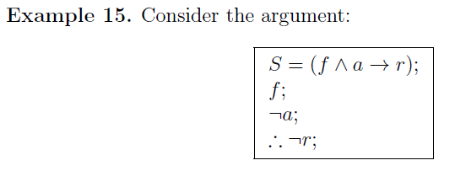
Check whether this argument is valid.

Slide 40
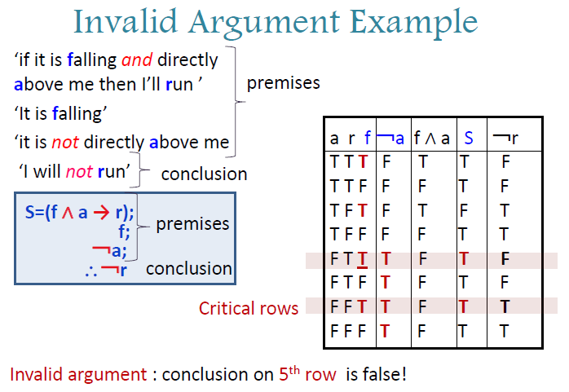

Slide 41
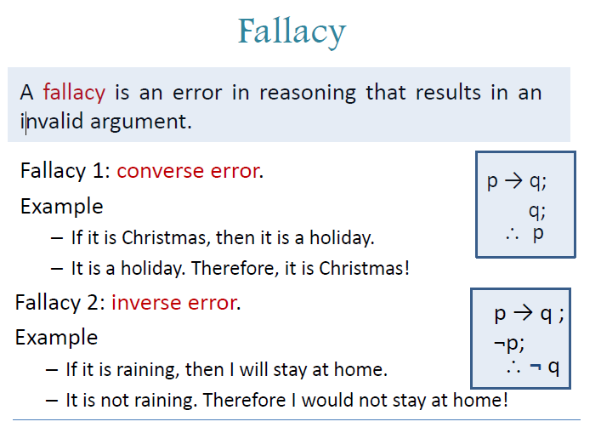

Slide 42
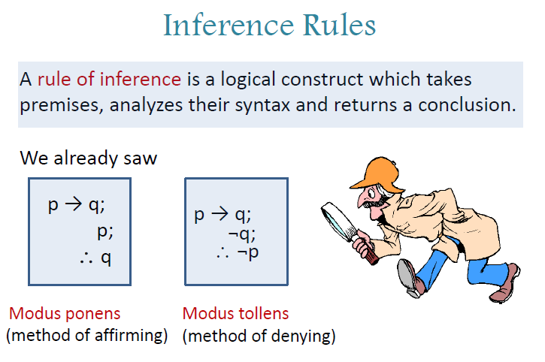

Slide 43
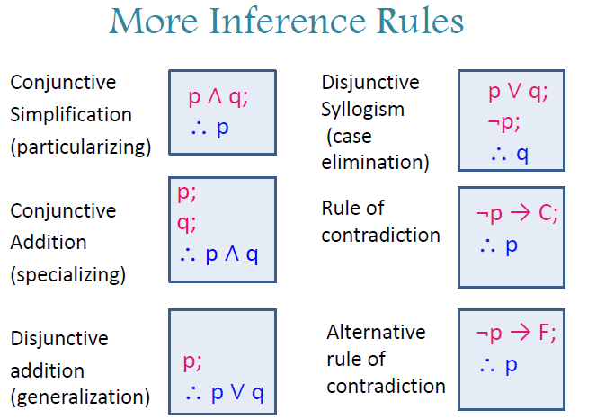

Slide 44
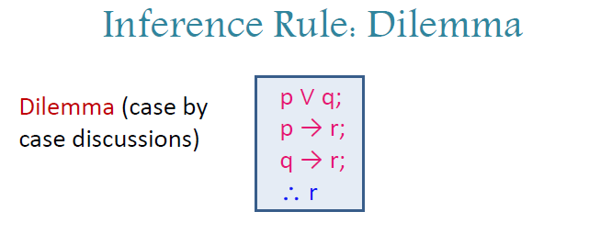

Slide 45
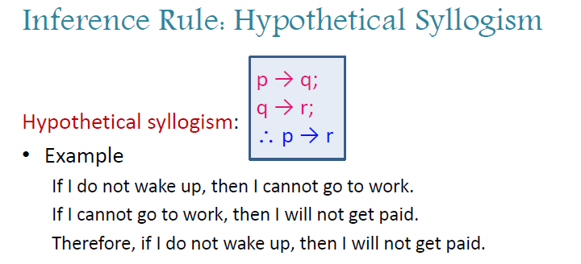

Slide 46
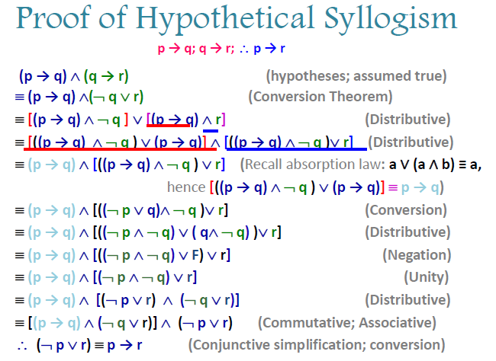

Slide 47
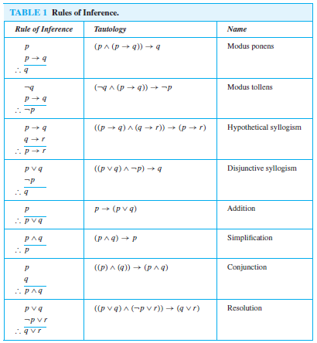

Slide 48

Inference rule: Resolution
Example: Show that the premises (p ∧ q) ∨ r and r → s imply the conclusion p ∨ s.
Solution: We can rewrite the premises (p ∧ q) ∨ r as two clauses, p ∨ r and q ∨ r. We can also replace r → s by the equivalent clause ¬r ∨ s. Using the two clauses p ∨ r and ¬r ∨ s, we can use resolution to conclude p ∨ s.

Slide 49

Example: Show that the premises “It is not sunny this afternoon and it is colder than yesterday,” “We will go swimming only if it is sunny,” “If we do not go swimming, then we will take a canoe trip,” and “If we take a canoe trip, then we will be home by sunset” lead to the conclusion “We will be home by sunset.”
Solution: Let
p =“It is sunny this afternoon,”
q = “It is colder than yesterday,”
r = “We will go swimming,”
s = “We will take a canoe trip,”
t = “We will be home by sunset.”
We need to construct an argument to show that the premises
lead to the desired conclusion t.

Slide 50
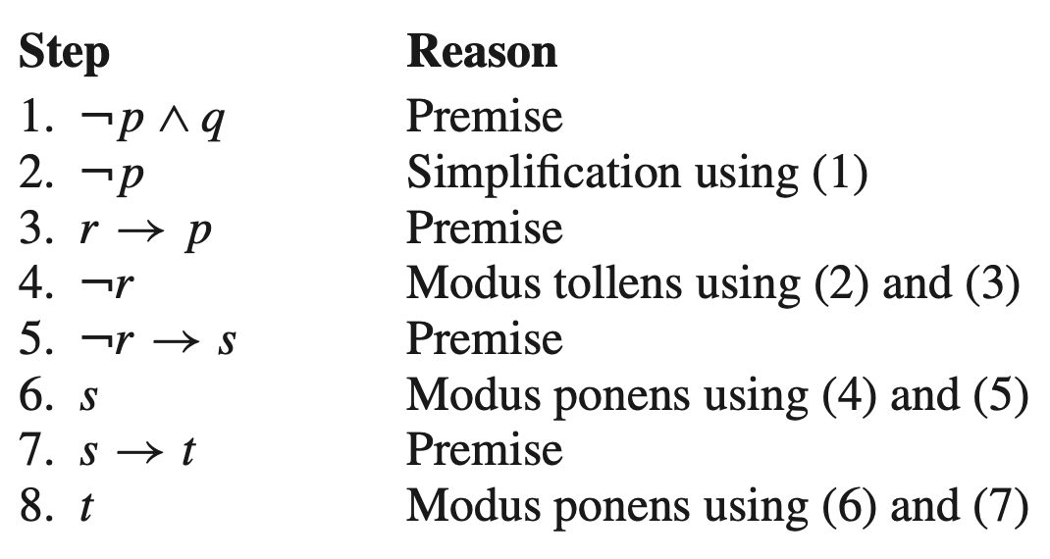

Slide 51
Example: Show that the premises “If you send me an e-mail message, then I will finish writing the program,” “If you do not send me an e-mail message, then I will go to sleep early,” and “If I go to sleep early, then I will wake up feeling refreshed” lead to the conclusion “If I do not finish writing the program, then I will wake up feeling refreshed.”
Solution: Let
p =“You send me an e-mail message,”
q = “I will finish writing the program,”
r = “I will go to sleep early,”
s = “I will wake up feeling refreshed.”
Then the premises are p → q, ¬p → r, and r → s.
The desired conclusion is ¬q → s.

Slide 52


Slide 53


Slide 54


Slide 55

Logic circuit
Definition: A logic circuit (or digital circuit) receives input signals, each a bit [either 0 (off) or 1 (on)], and produces output signals, each a bit.
We will restrict our attention to logic circuits with a single output signal; in general, digital circuits may have multiple outputs.

Slide 56


Example 1: Determine the output for the combinatorial circuit in the figure.
Example 2: Build a digital circuit that produces the output

